Slide 1















A – Predicting Factory Machine Status
Seow Yue Jia Tiffanee (p2415732)
11:11PM

Slide 2
















Dataset
Feature | Description
Unique ID | the unique identifier
Product ID | the product ID
Quality | the machine quality, L=Low, M=Medium, H=High
Ambient T | the ambient temperature
Process T | the process temperature
Rotation Speed | the machine rotation speed measured in rpm (rounds per minute)
Torque | the torque of the machine
Tool Wear | the time of tool wear
Machine Status (Target) | 0 means normal, 1 means abnormal

Slide 3
1
Data Analysis and Preparation
Back to Agenda Page

Slide 4

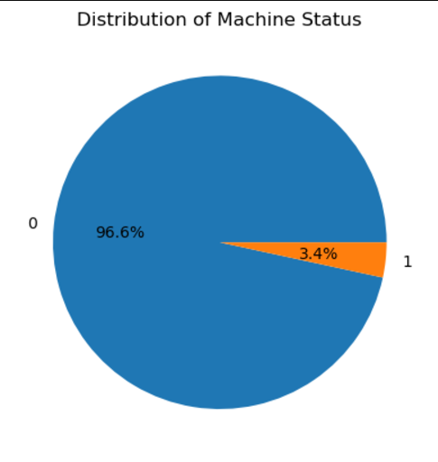
Target Feature
Observations:
There is class imbalance between the two classes, 0 (normal) and 1 (abnormal)
0 => 96.6% and 1 => 3.4%
Back to Agenda Page

Slide 5
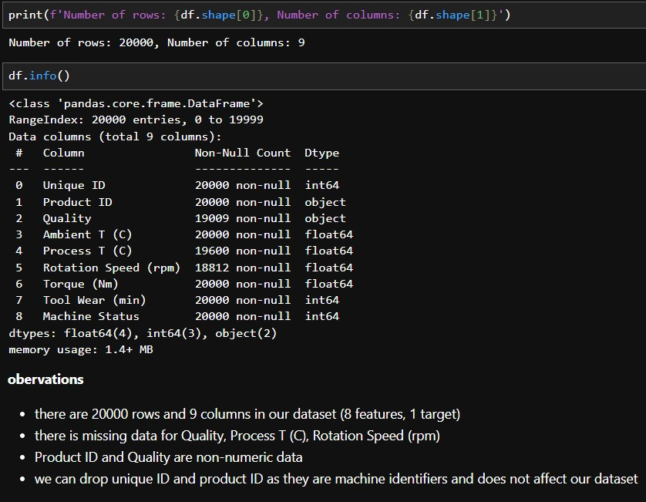
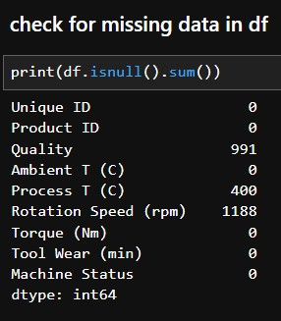
Descriptive Statistics
Observations:
There are 20000 columns and 9 rows
There are missing values
Quality and Product ID are categorial data types
Back to Agenda Page

Slide 6

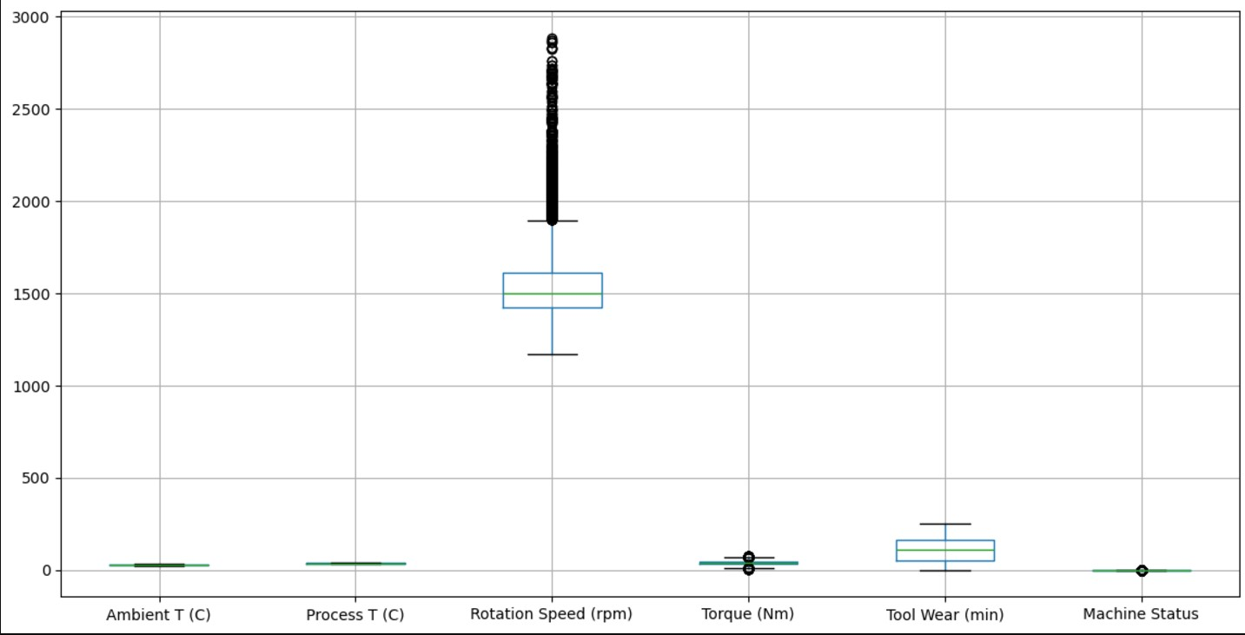
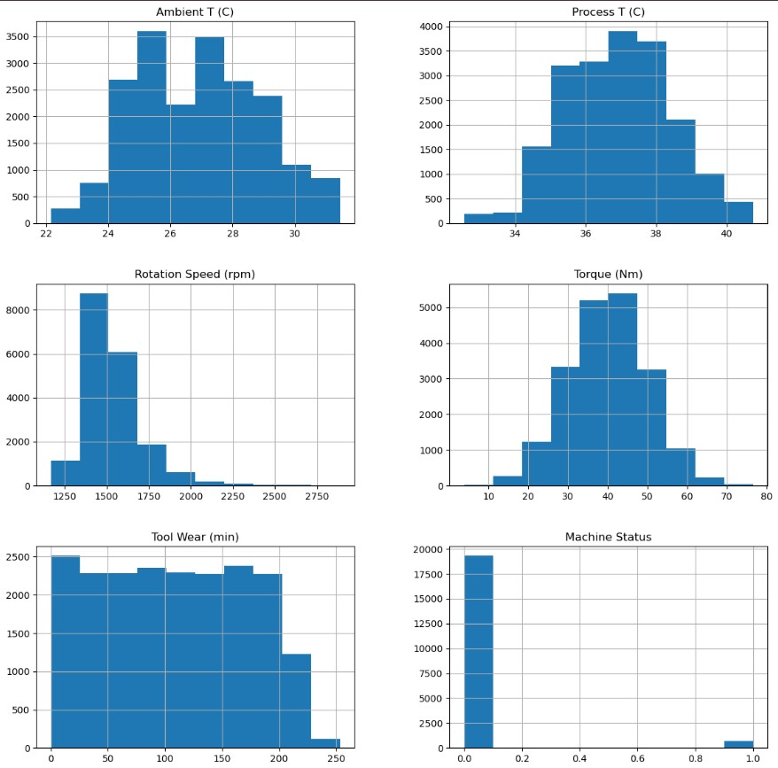
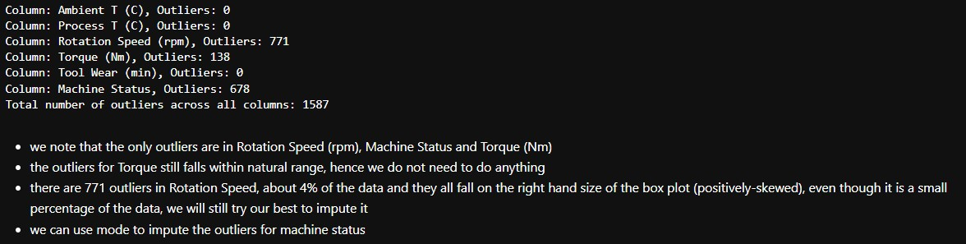
Univariate Analysis

Slide 7
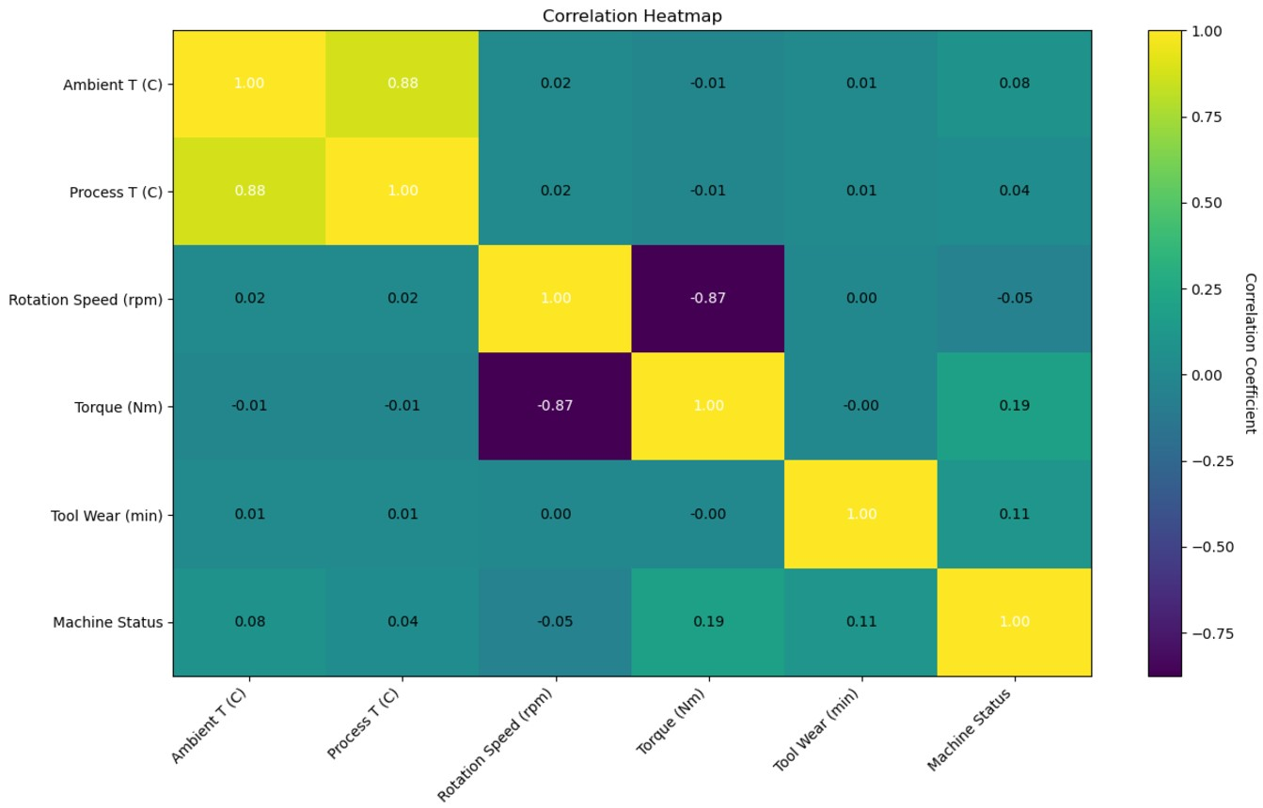
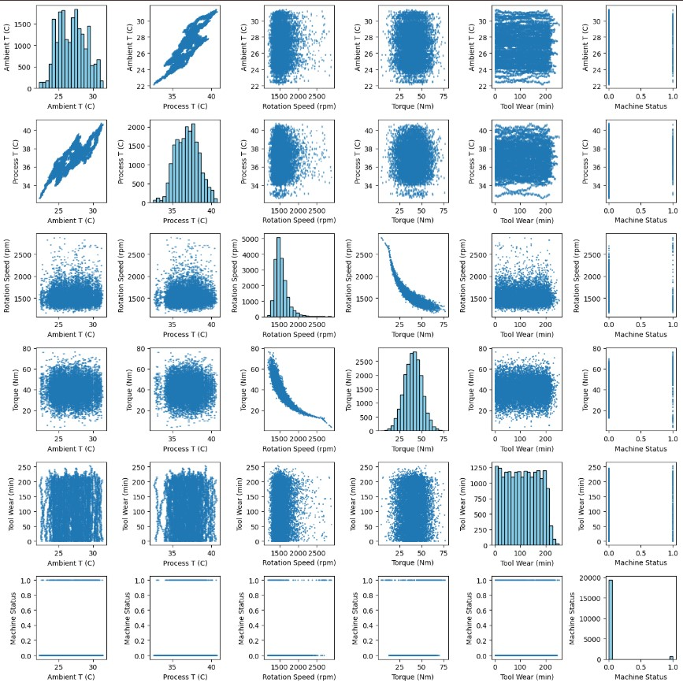
Bivariate Analysis

Slide 8
2
Model Building and Evaluation
Back to Agenda Page

Slide 9
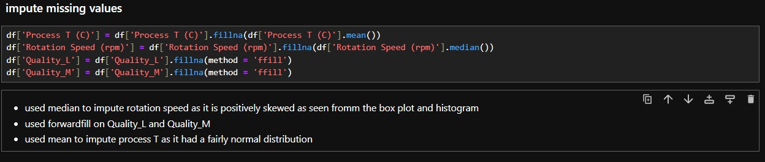
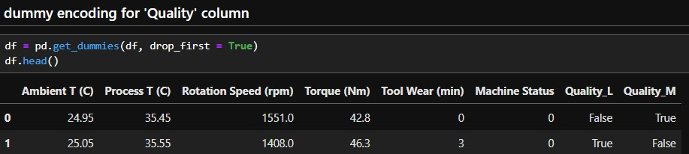
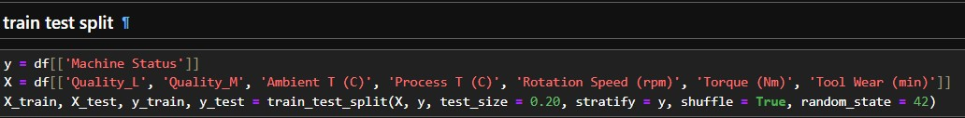
Imputing missing values, Encoding categorial features, and Handling outliers
Back to Agenda Page

Slide 10


Evaluation Metrics
Accuracy measures the ratio of correctly predicted instances to the total number of instances.
Recall measures the ability of a model to capture all the relevant instances.
The F1 score is the harmonic mean of precision and recall. It provides a balance between precision and recall.
Precision focuses on the accuracy of the positive predictions.

Slide 11
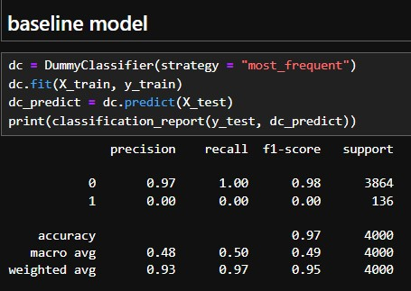
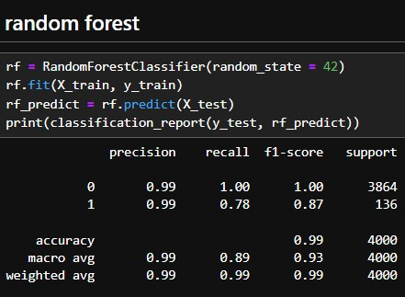
Model Selection

Slide 12
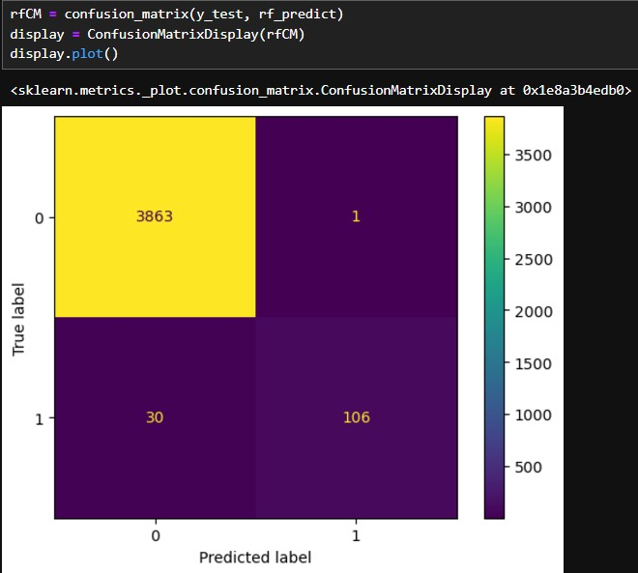
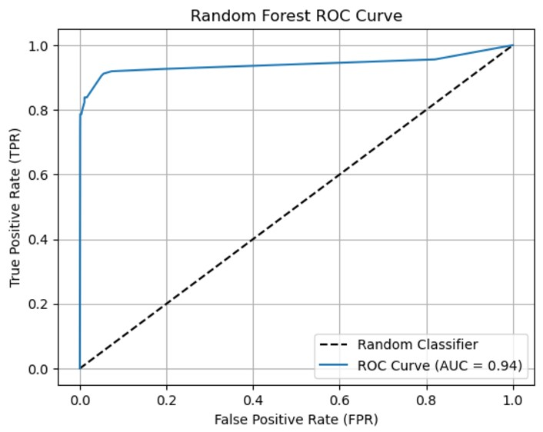
Random Forest Evaluation

Slide 13
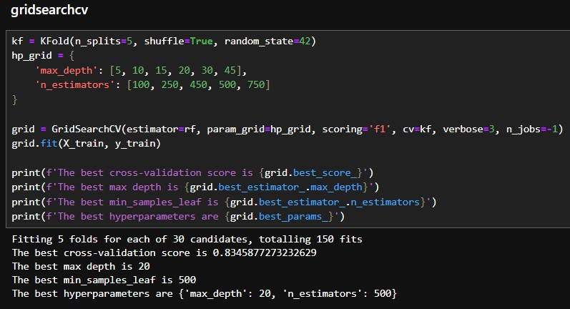
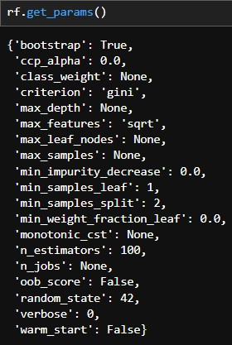
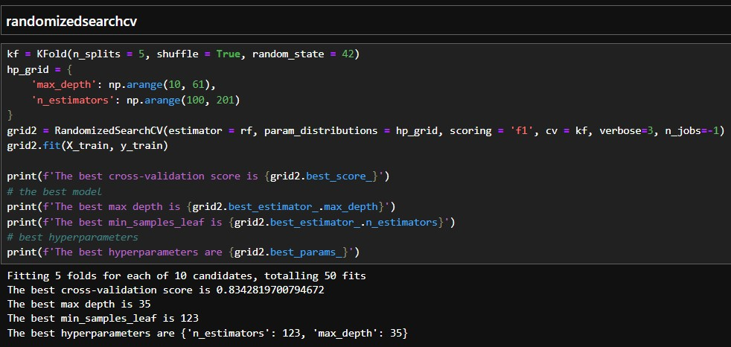
Model Improvements

Slide 14
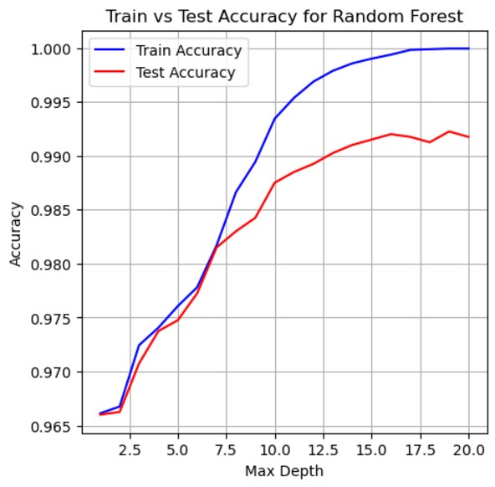
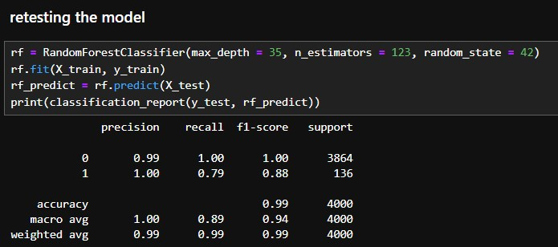
Classification Report

Slide 15
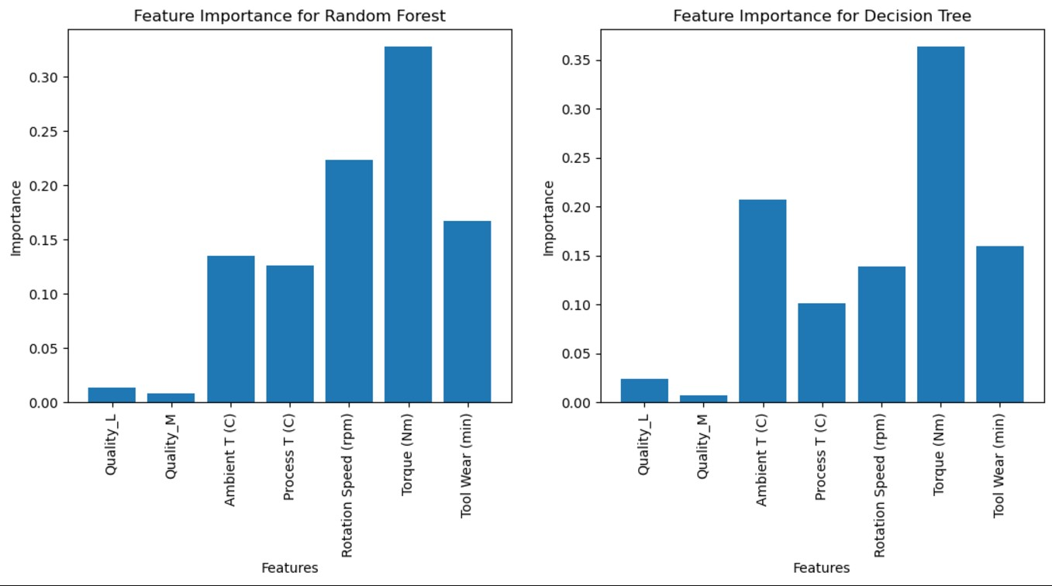
Feature Importance

Slide 16
Conclusion
Random Forest is the best model to predict whether the machine is working properly or if its faulty as it has the highest recall and f1 score.
Torque has the most importance for the features, with rotation speed being the second highest for our best model, random forest.
This tells us that the process the machine goes through affects the fact if it is working properly or not, rather than factors like quality of the machine or the temperature.

